Slide 1
What Needs to Happen in a Scholarly Publishing Reform?
Björn Brembs, Freie Universität Berlin
http://brembs.net
http://www.slideshare.net/brembs/whats-wrong-with-scholarly-publishing-today-ii

Slide 2
Publishing yesterday…
1665: One journal: Philosophical Transactions of the Royal Society of London (Henry Oldenburg)

Slide 3
Publishing Today
24,000 scholarly journals
1.5 million publications/year
3% annual growth
1 million authors
10-15 million readers at >10,000 institutions
1.5 billion downloads/year
Source: Mabe MA (2009): Scholarly Publishing. European Review 17(1): 3-22

Slide 4
Functionality
19th century publishing for a 21st century scientific community

Slide 5
Functionality
At least four different search tools to be sure not to miss any relevant literature?

Slide 6
Functionality
And that‘s not even counting the hours spent trying to screen the freshly published literature!

Slide 7
Scholarly Publishing
Identity Crisis
How can I find anything?

Slide 8
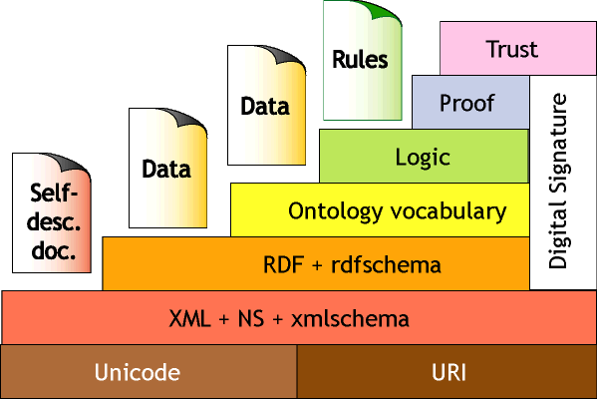
Semantic Web
Machine-readable meaning
Technically non-trivial
Promising progress
Tim Berners-Lee
http://www.w3.org/2000/Talks/1206-xml2k-tbl/Overview.html

Slide 9
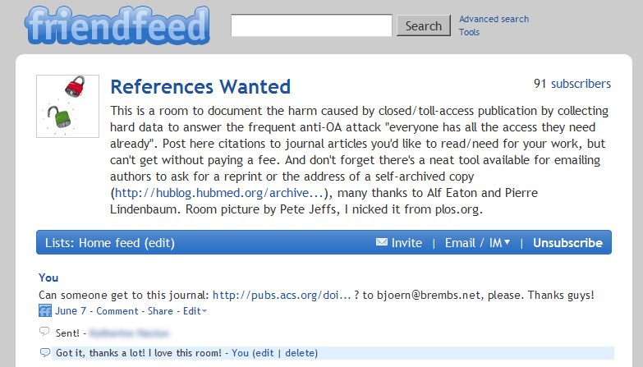
Functionality
When we finally find the reference, we have to ask friends with rich libraries to send the PDF to us?

Slide 10
Functionality
By the time we finally have the paper, we have run out of time to actually read it…

Slide 11
Functionality
We have to re-format our manuscripts every time an ex-scientist tells us to submit to another journal?

Slide 12
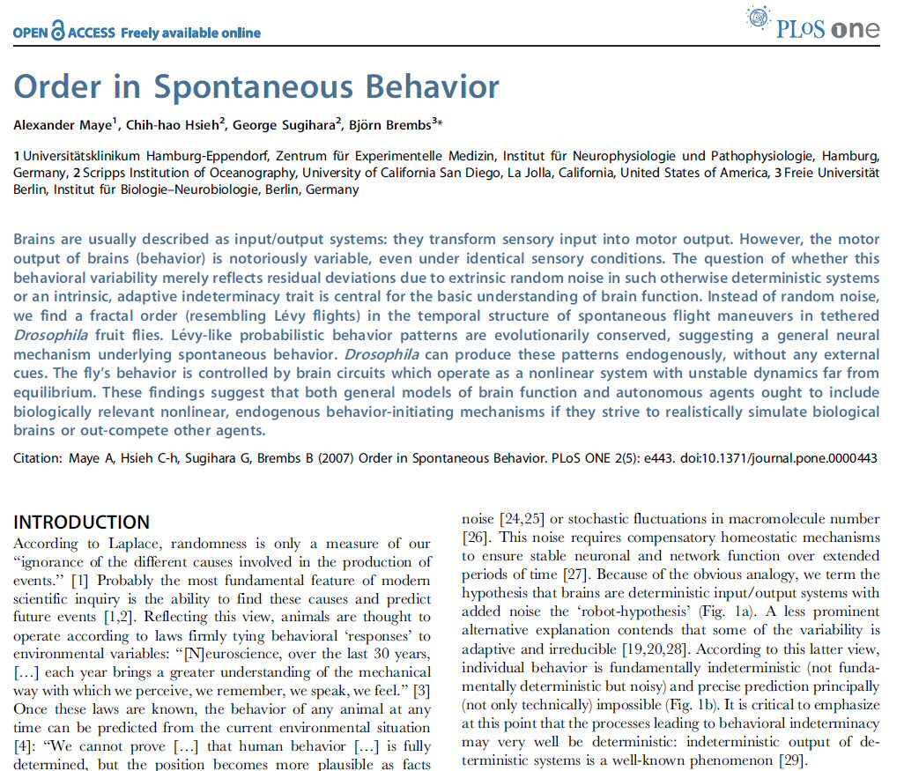
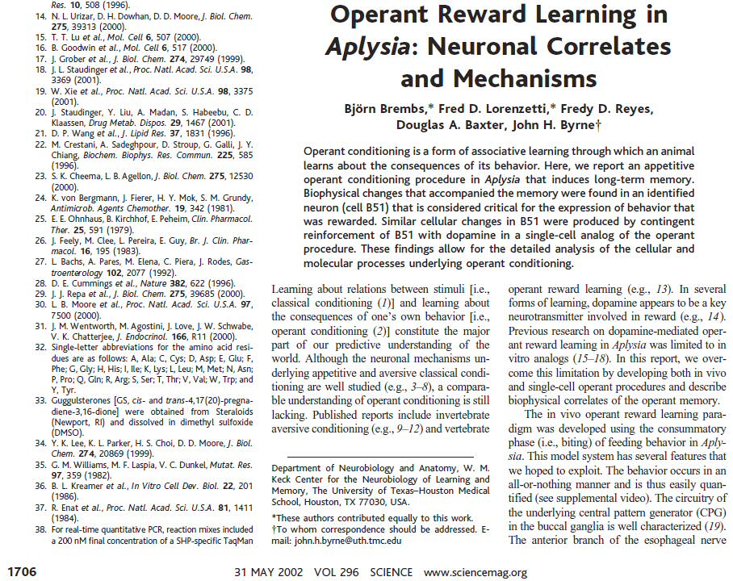
Functionality
We have to re-format our manuscripts every time an ex-scientist tells us to submit to another journal?

Slide 13
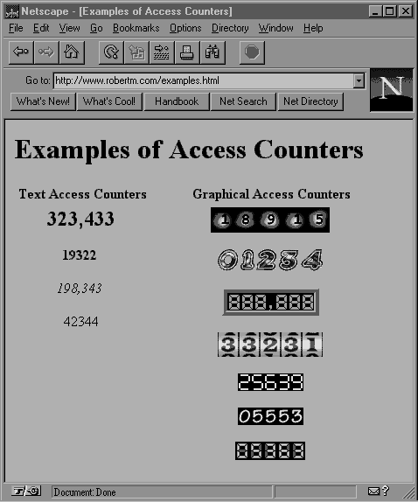
Functionality
Every homepage has had an access counter since 1993 but we don’t know how often our paper has been downloaded?

Slide 14
Functionality
Nothing happens when we click on the reference after "we performed the experiments as described previously"?

Slide 15
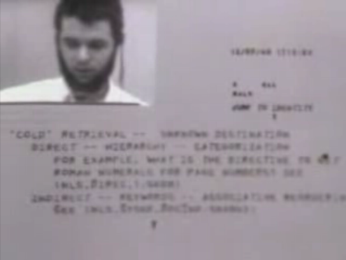
Hyperlinks
Nothing happens when we click on the reference after "we performed the experiments as described previously"?
First demonstration: 1968
WWW: 1989
Stanford Research Institute: NLS
Tim Berners-Lee: CERN

Slide 16
Think…

Slide 17
Why?
Who‘s to blame that our publishing system is so lame?

Slide 18
We, the scientists!
We decide how and where to publish

Slide 19
We, the scientists!
We are producers and consumers in personal union

Slide 20
We, the scientists!
We chose to outsource scientific communication to publishers

Slide 21
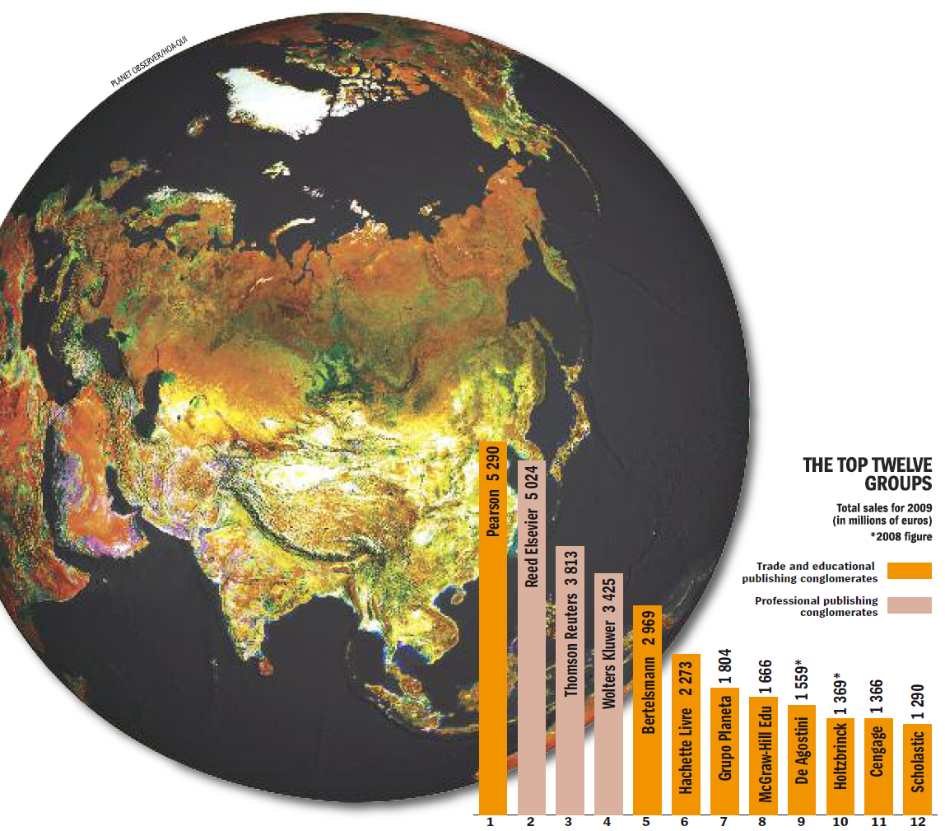
The Big Three (2009/10)
Employees | Sales | Net income | Growth
57,900 | $13B | $1B | 7.6%
33,300 | $10B | $0.6B | 9.4%
19,030 | $5B | $0.5B | 125.7%
(includes Springer)
Source:
http://www.publishersweekly.com/binary-data/ARTICLE_ATTACHMENT/file/000/000/127-1.pdf

Slide 22
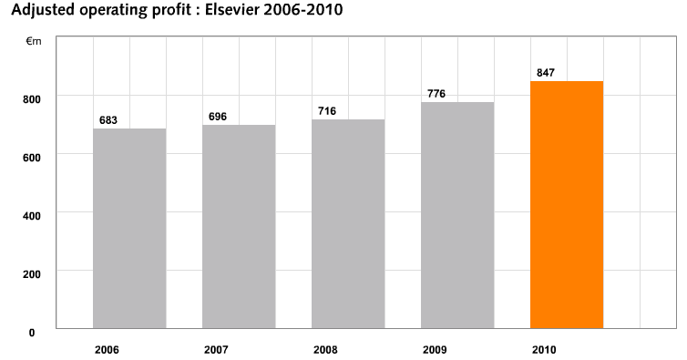
Profits

Slide 23
Journals Crisis (not just Elsevier!)
% Change
Modified from ARL: http://www.arl.org/bm~doc/arlstats06.pdf, http://www.arl.org/bm~doc/arlstat08.pdf

Slide 24
Subscription Pricing
KIT Library
10 Most expensive journal subscriptions 2010/11
Journal | Price [€/a] | Publisher
Biochimica et Biophysica Acta | 19,130.53 | Elsevier
Chemical Physics Letters | 15,577.06 | Elsevier
Journal of Organometallic Chemistry | 13,664.97 | Elsevier
Journal of Radioanalytical and Nuclear Chemistry | 13,381.07 | Springer
Nuclear Instruments & Methods in Physics Research / A | 11,958.32 | Elsevier
Surface Science | 11,796.75 | Elsevier
Inorganica Chimica Acta | 10,703.21 | Elsevier
Journal of Mathematical Analysis and Applications | 10,692.75 | Elsevier
Journal of Coordination Chemistry | 10,314.92 | Taylor & Francis
Journal of Magnetism and Magnetic Materials | 10,047.30 | Elsevier
Total top ten: | 127,266.88
http://www.bibliothek.kit.edu/cms/teuerste-zeitschriften.php

Slide 25
Scientific Publishing:

Slide 26
Think…

Slide 27
Digital dystopia
Or filter failure?
Information (Overload) Crisis

Slide 28
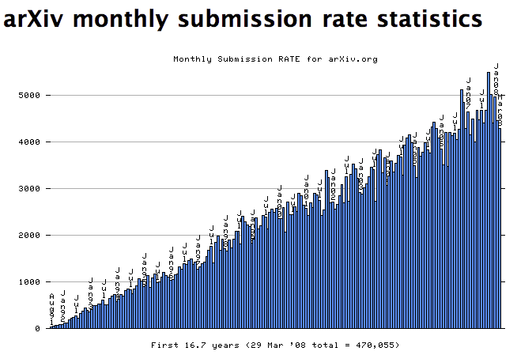
More scientists, more publications

Slide 29
Information Crisis
1.5 million publications per year in 24,000 journals

Slide 30
Information Crisis
Finding ‘my’ publications is impossible!

Slide 31
Information Crisis
Publish or Perish: number of publications

Slide 32
Information Crisis
60-300 applicants per tenure-track position

Slide 33
Information Crisis
Reading enough publications is impossible!

Slide 34
Think…

Slide 35
One solution: JournalRank
Source Normalized Impact per Paper
Thomson Reuters: Impact Factor
Eigenfactor (now Thomson Reuters)
ScImago JournalRank (SJR)
Scopus: SNIP, SJR

Slide 36
One solution: JournalRank
Only read publications from high-ranking journals

Slide 37
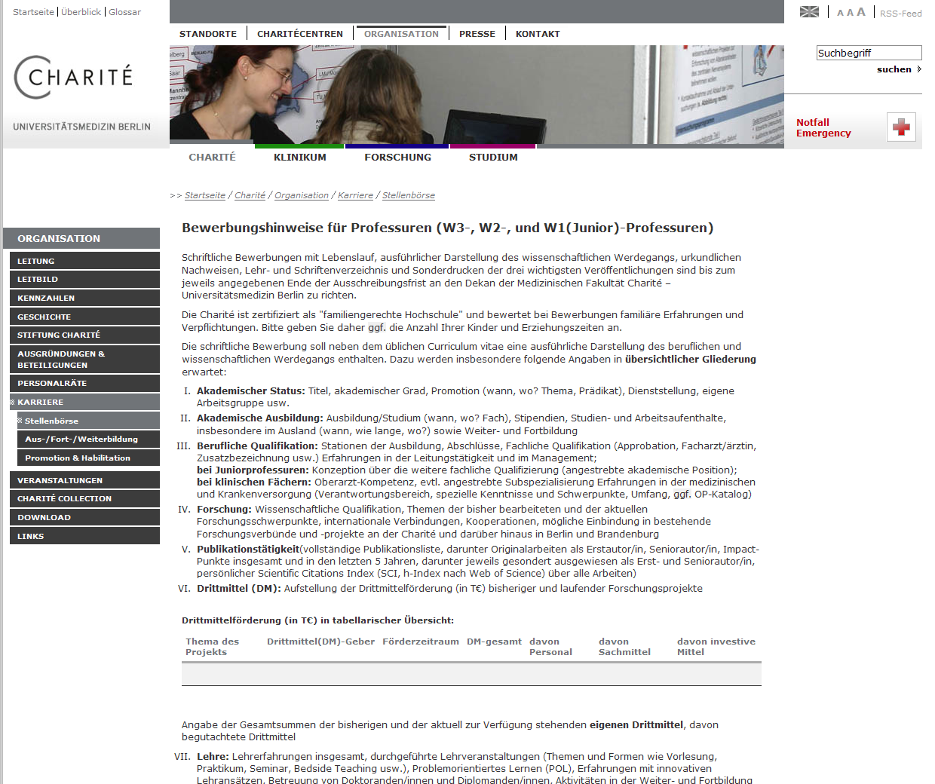
Job applications

Slide 38
Job application instructions
Publikationstätigkeit
(vollständige Publikationsliste, darunter Originalarbeiten als Erstautor/in, Seniorautor/in, Impact-Punkte insgesamt und in den letzten 5 Jahren, darunter jeweils gesondert ausgewiesen als Erst- und Seniorautor/in, persönlicher Scientific Citations Index (SCI, h-Index nach Web of Science) über alle Arbeiten)
Publications:
Complete list of publications, including original research papers as first author, senior author, impact points total and in the last 5 years, with marked first and last-authorships, personal Scientific Citations Index (SCI, h-Index according to Web of Science) for all publications.

Slide 39
Metrics
Lies, damn lies and bibliometrics

Slide 40
Show of hands:
Who knows what the IF is?
Who uses the IF to pick a journal (rate a candidate, etc.)?
Who knows how the IF is calculated and from what data?

Slide 41
The Impact Factor
Introduced in 1960’s by Eugene Garfield: ISI
citations
articles
2010
2008 and 2009
IF=5
Articles published in 08/09
were cited an average of 5 times in 10.

Slide 42
The Impact Factor
Journal X IF 2010=
All citations from TR indexed journals in 2010 to papers in journal X
Number of citable articles published in journal X in 2008/9
€30,000-130,000/year subscription rates
Covers ~11,500 journals (Scopus covers ~16,500)

Slide 43
Main Problems with the IF
Negotiable
Irreproducible
Mathematically unsound

Slide 44
Negotiable
PLoS Medicine, IF 2-11 (8.4) (The PLoS Medicine Editors (2006) The Impact Factor Game. PLoS Med 3(6): e291. http://www.plosmedicine.org/article/info:doi/10.1371%2Fjournal.pmed.0030291)
Current Biology IF from 7 to 11 in 2003
Bought by Cell Press (Elsevier) in 2001…

Slide 45
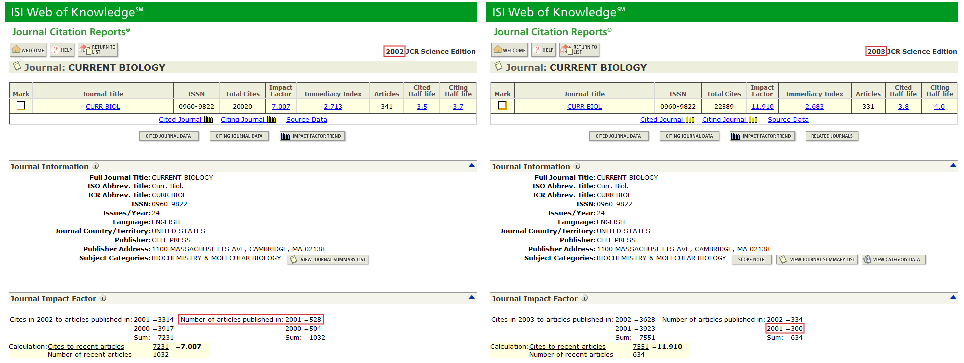

Slide 46
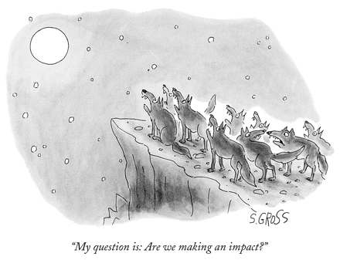
Not Reproducible
Rockefeller University Press bought their data from Thomson Reuters
Up to 19% deviation from published records
Second dataset still not correct
Rossner M, van Epps H, Hill E (2007): Show me the data. The Journal of Cell Biology, Vol. 179, No. 6, 1091-1092 http://jcb.rupress.org/cgi/content/full/179/6/1091

Slide 47
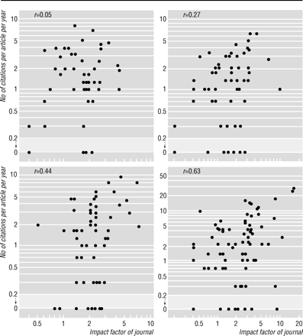
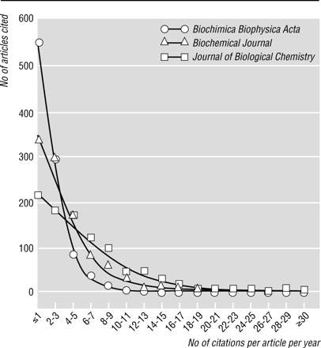
Not Mathematically Sound
Left-skewed distributions
Weak correlation of individual article citation rate with journal IF
Seglen PO (1997): Why the impact factor of journals should not be used for evaluating research. BMJ 1997;314(7079):497 (15 February)
http://www.bmj.com/cgi/content/full/314/7079/497

Slide 48
IF better predictor of retractions
Fang FC, Casadevall A (2011): RETRACTED SCIENCE AND THE RETRACTION INDEX. Infect. Immun. doi:10.1128/IAI.05661-11 http://iai.asm.org/content/early/2011/08/08/IAI.05661-11.full.pdf+html?view=long&pmid=21825063

Slide 49
Job applications

Slide 50
Message:
We only hire people who publish in journals with a lot of retractions!

Slide 51
Think…

Slide 52
Albert Einstein
"Not everything that can be counted counts, and not everything that counts can be counted."

Slide 53
Metrics
Need to be developed and applied according to scientific standards

Slide 54
Databases
2009: 1,230 databases online in molecular and cell biology

Slide 55
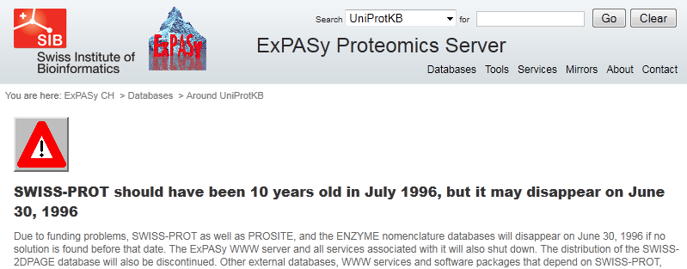

Slide 56
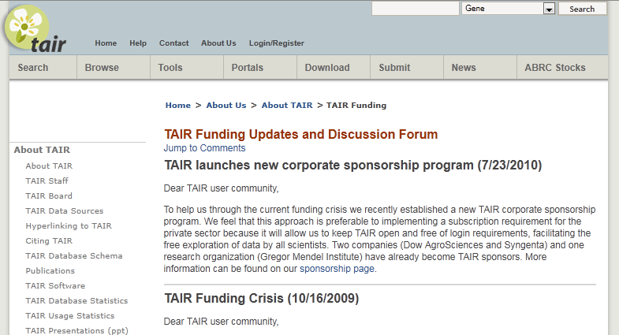

Slide 57
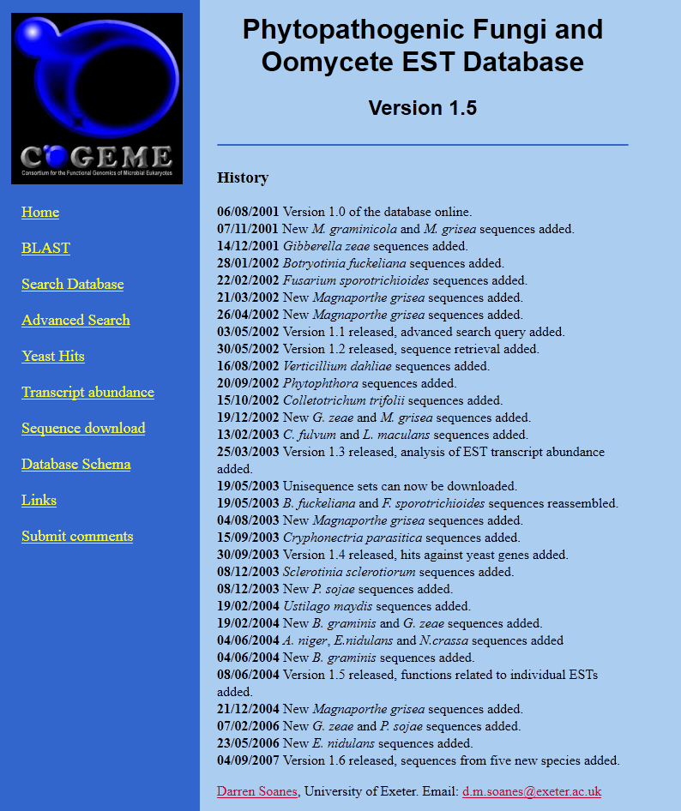

Slide 59
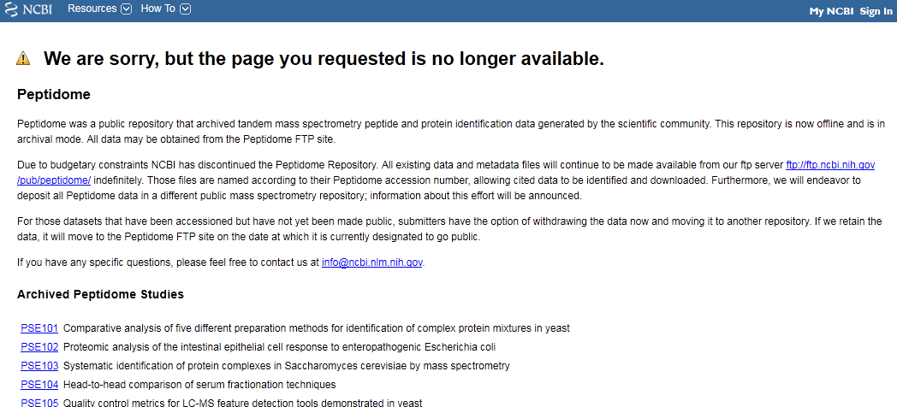

Slide 60
My Digital Utopia:
No more publishers – libraries archive everything according to a world-wide standard
Single semantic, decentralized database of literature and data
Personalized filtering
Peer-review administrated by an independent body
Link typology for text/text, data/data and text/data links (“citations”)
Semantic Text/Datamining
All the metrics you (don’t) want (but need)
Tagging, bookmarking, etc.
Unique contributor IDs with attribution/reputation system (teaching, reviewing, curating, blogging, etc.)
IT assisted push/alert service
Technically feasible today (almost)

Slide 61
Which way?
How to get to my digital utopia?

Slide 62
Libraries cut their subscriptions by the maximum contractually allowed amount

Slide 63
Every year!

Slide 64
Eventually, libraries should be able to invest the corporate profits of 2-4b €/$ per year

Slide 65
4b € per year for 10,000 university libraries: 400,000 € per year per library

Slide 66
Libratopia Investments
Open Access funds for complaining faculty
Infrastructure and know-how (man-power) for a single, decentralized, federated scholarly publishing framework for literature and data.

