Slide 1


Enhanced Publications in the Netherlands
A durable repository infrastructure
Maarten Hoogerwerf
Project Manager / Consultant
SWIB11, ECO4R Workshop
28 November 2011
Data Archiving and Networked Services

Slide 2
Overview
State of the art in Netherlands
  SURFshare and the Enhanced Publication tender projects
Experience with interoperability
  Enhanced Publications in Narcis research portal
Experience with durability
  Durable Enhanced Publications

Slide 3
State of the art
(in a nutshell)

Slide 4
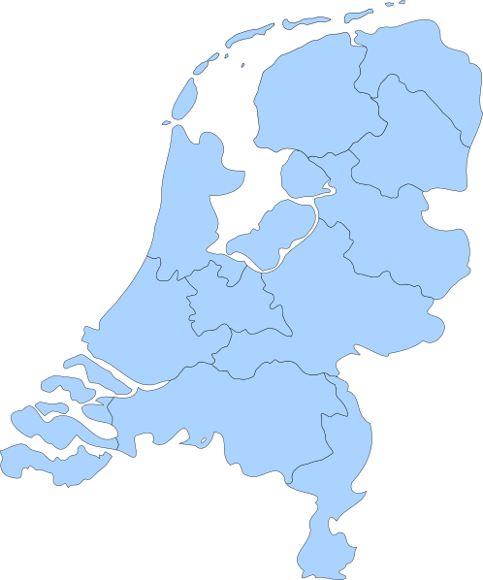



> 25 institutional repositories
- MPEG21-DIDL + MODS
- URN:NBN
- Digital Author Identifier
- Data Seal of Approval
- OAI-PMH
- SRU/SRW
Notes:
Over 25 repositories
Collaborating via SURFfoundation: sharing metadata standards, persistent identifiers, digital author identifiers
2 data repositories
All publications harvested by Royal Library for preservation in eDepot
All contents harvested by Narcis portal
All identifiers resolvable via PersID
The standards

Slide 5
Enhanced Publications
Why?
Authors publish online and want to attach or integrate research data
Repositories want to connect publications with research data
What?
Definition DRIVER II:
Enhanced publications are compound digital objects which combine different but related web resources. The basis is a traditional academic publication.
Notes:
Official motivation: More and more authors have desire to provide data and do so via personal non-durable websites
But also: repositories see opportunities
Driver defintiion: comes down to “a resourcemap with publication and other resources”

Slide 6
Examples
Notes:
Pure metadata, post-publication, no author/researcher involved. Pure out-of-the-box.

Slide 7

Enhanced Publications
2007
  DRIVER-II demonstrator
2008/2009
  JALC
  DatapluS
  Escape
  ProefschriftenPlus
  Veteran Tapes VP
  CORF/OA+
  …
2010/2011
  Open Data and Publications
  Lenguas de Bolivia
  The Other Josquin
  Enhancing Scholarly Publishing in the Humanities & Social Sciences
  Vpcross
  Enhanced Journals Made Easy
2011
  Durable Enhanced Publications
  Enhanced Publications in Narcis
Notes:
Emphasize communities
Emphasize tools
Emphasize repository-driven, researcher-driven and repository driven
Make sure you don’t go into details!!!

Slide 8
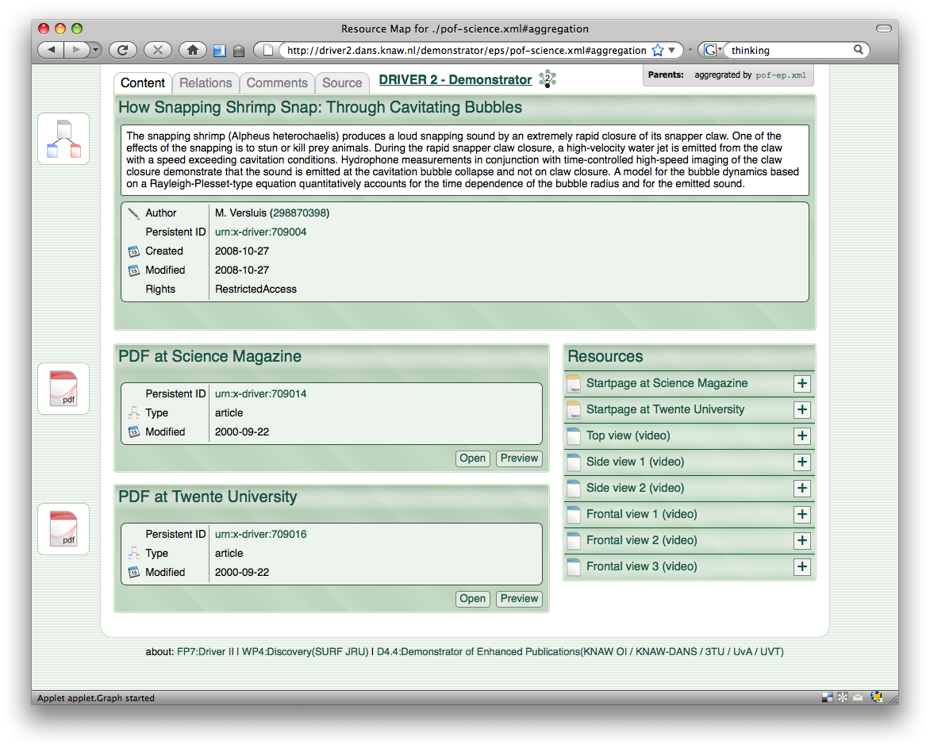
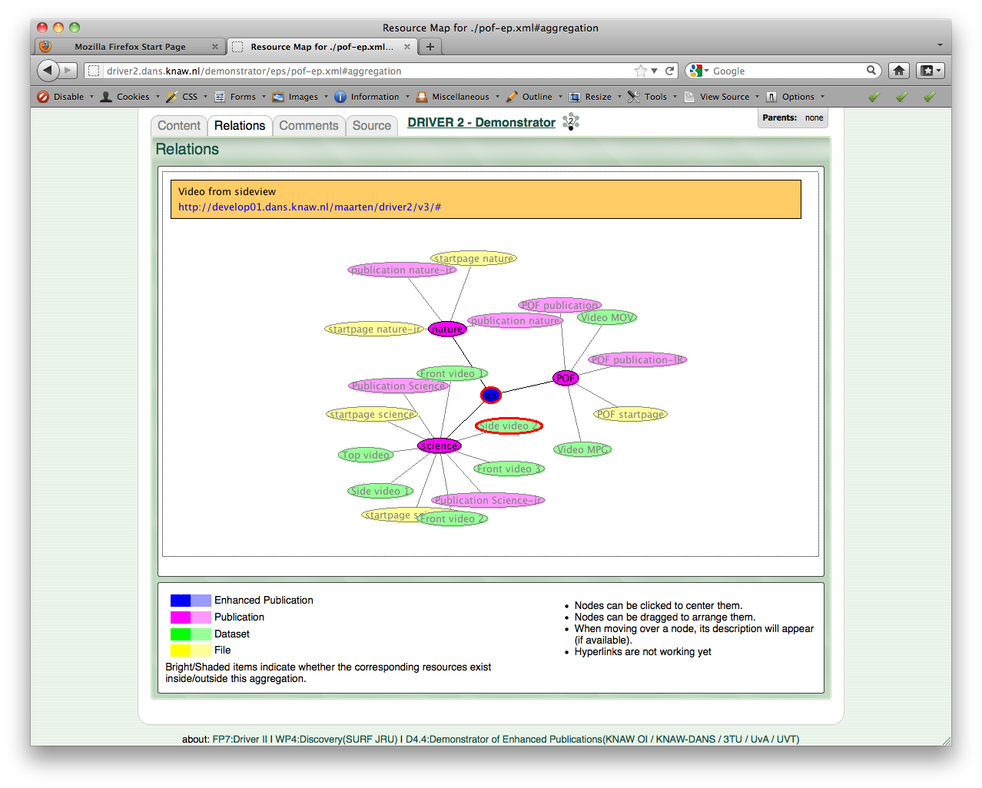
DRIVER II
Notes:
Driver2, out-of-the-box by repository community: connect available resources. Metadata level

Slide 9
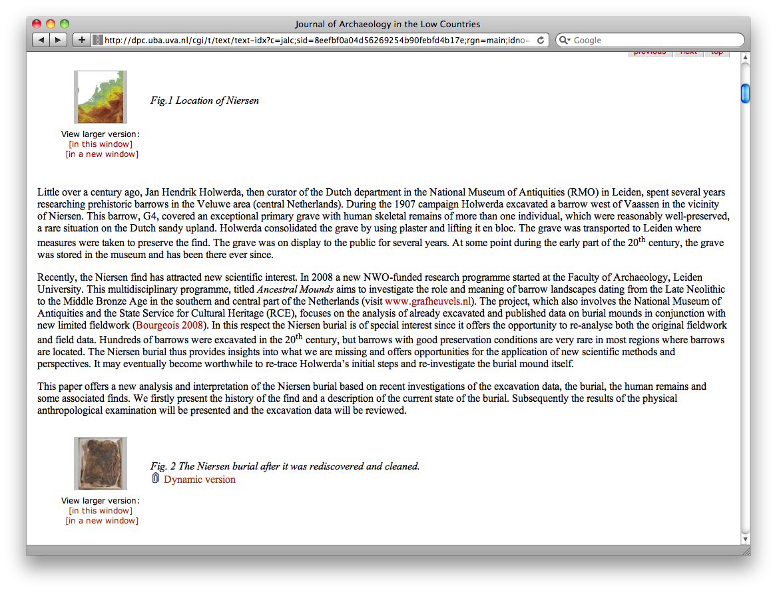
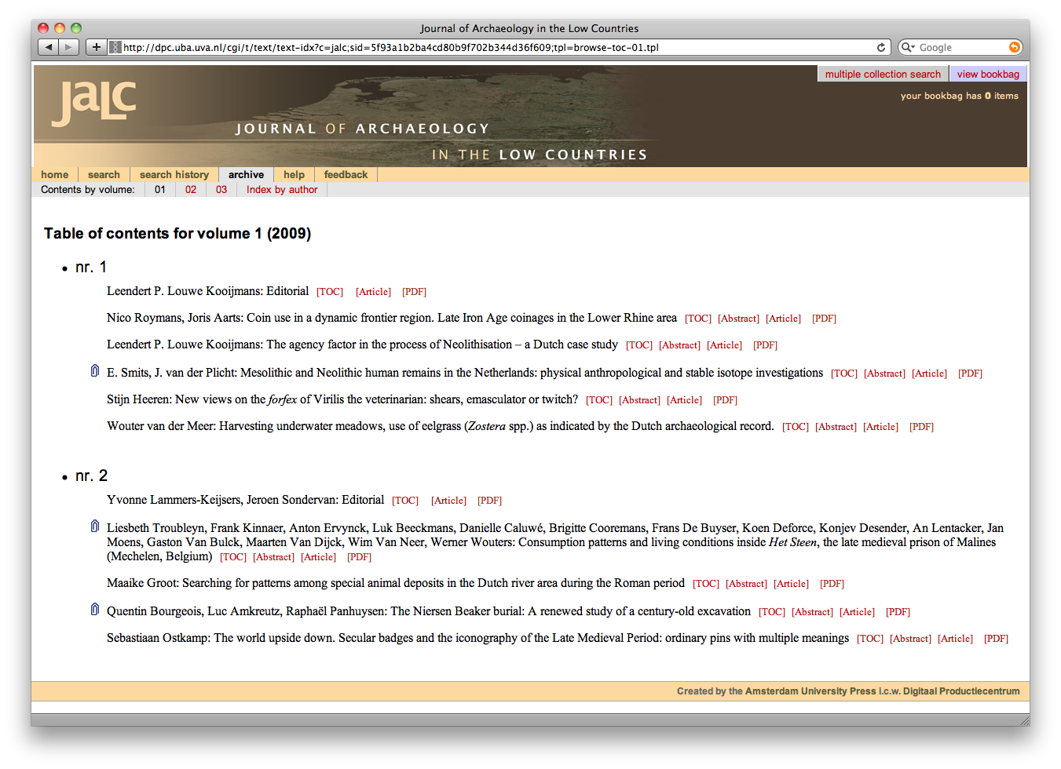
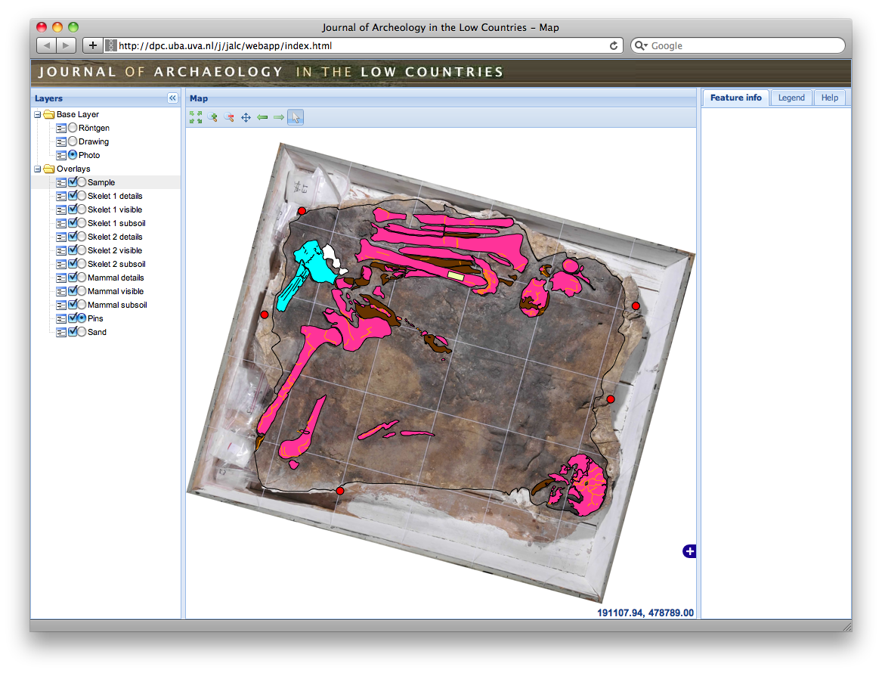
Journal of Archaeology in the Low Countries
Notes:
Archaeologists, focus on in-article presentation. LTP challenges were aspect of project. In-publication enhancements

Slide 10
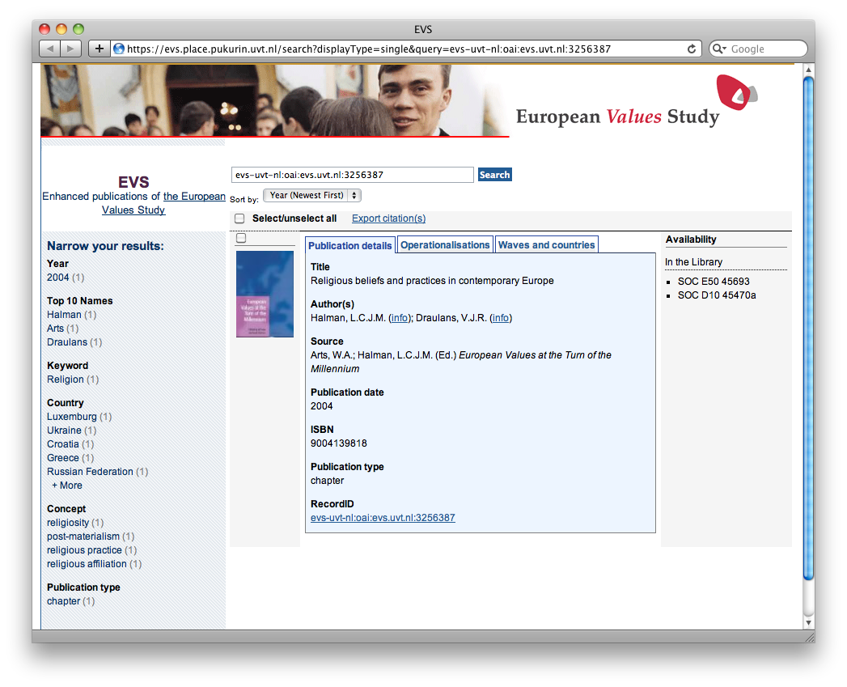
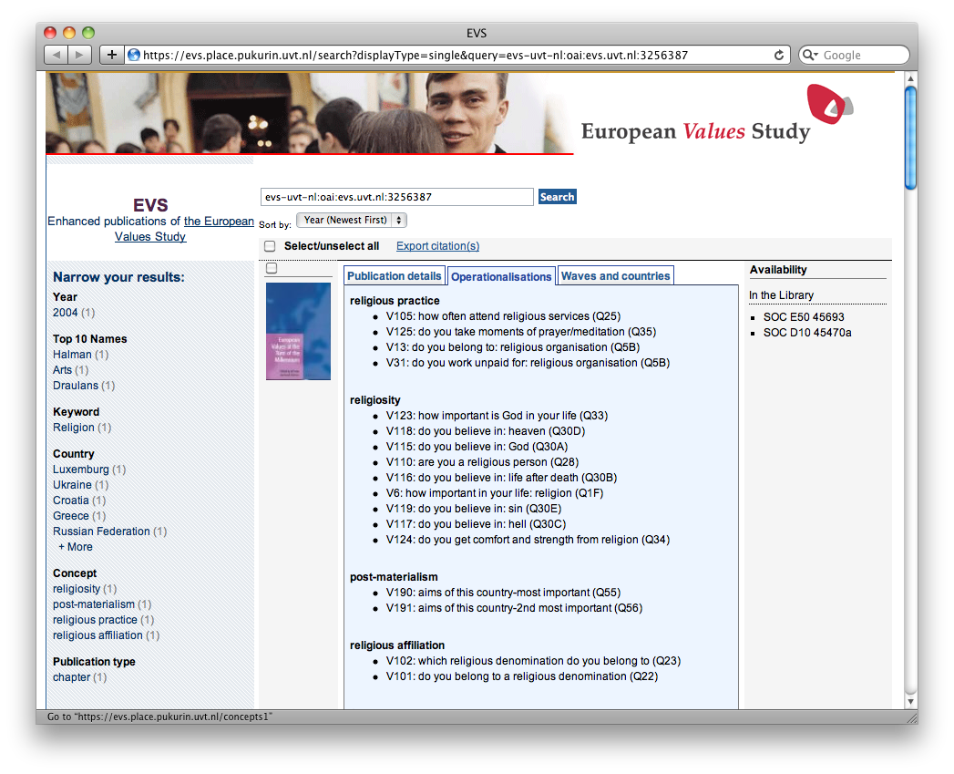
DatapluS
Notes:
Social science community, focus on portal for repository. Enrichment on level of metadata

Slide 11
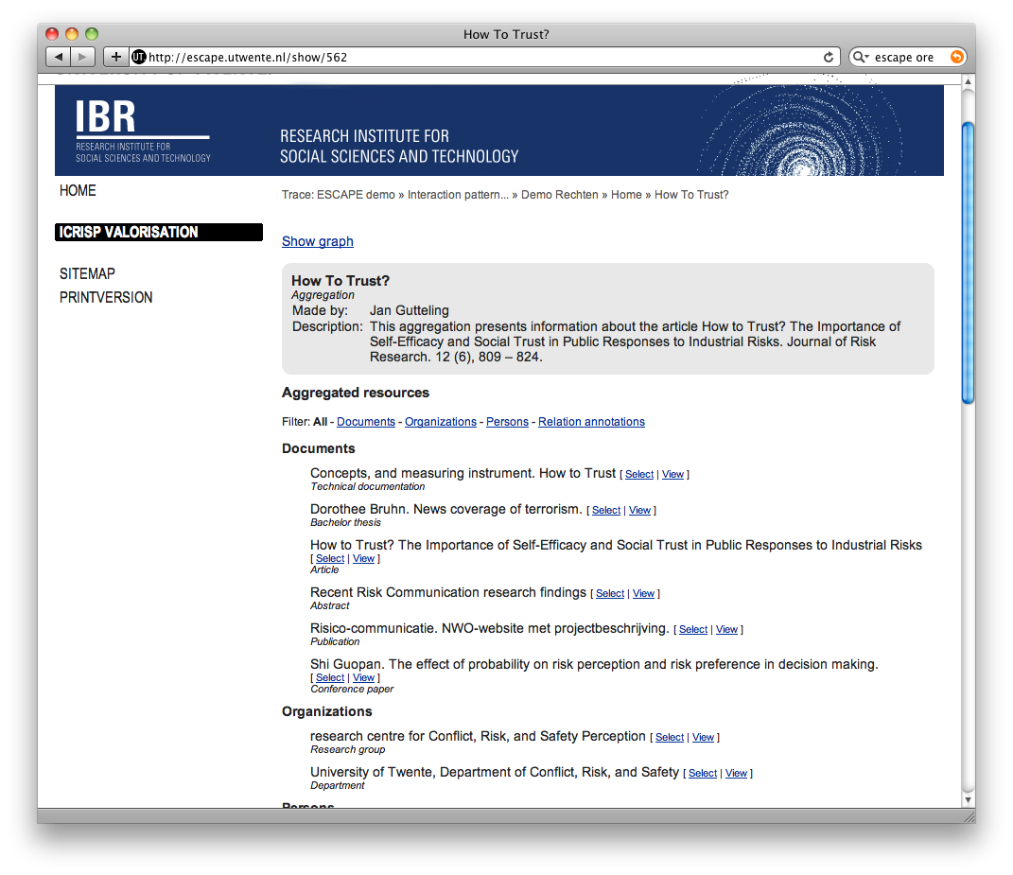
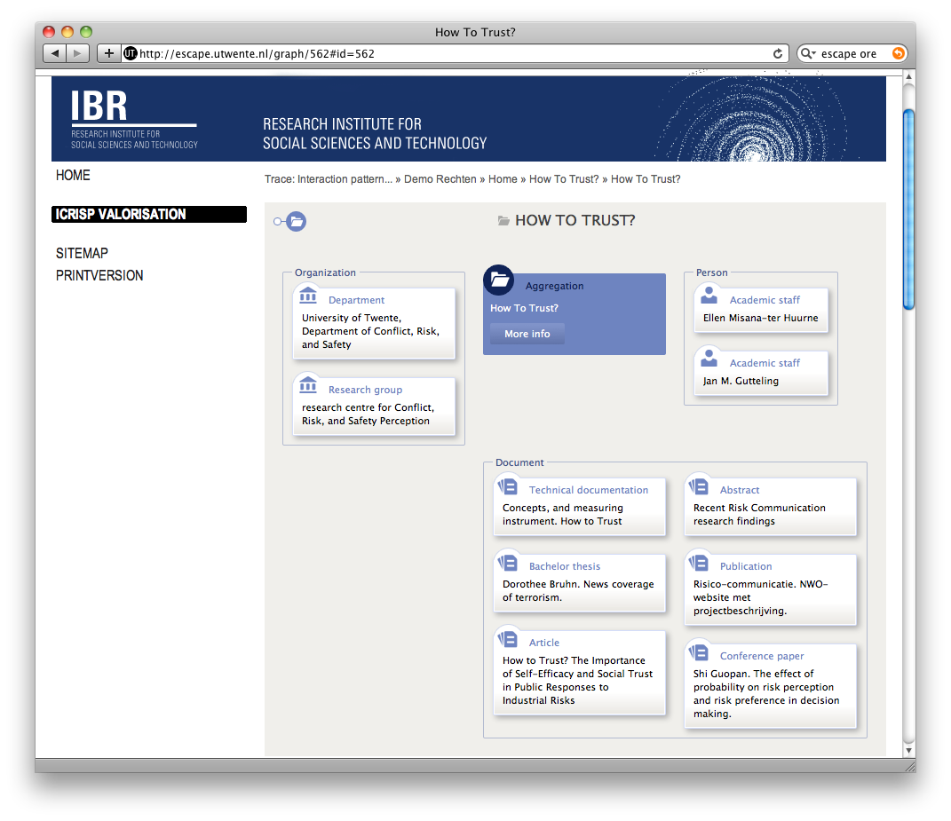
Escape
Notes:
Focus on creation of RM’s and visualizing them.

Slide 12
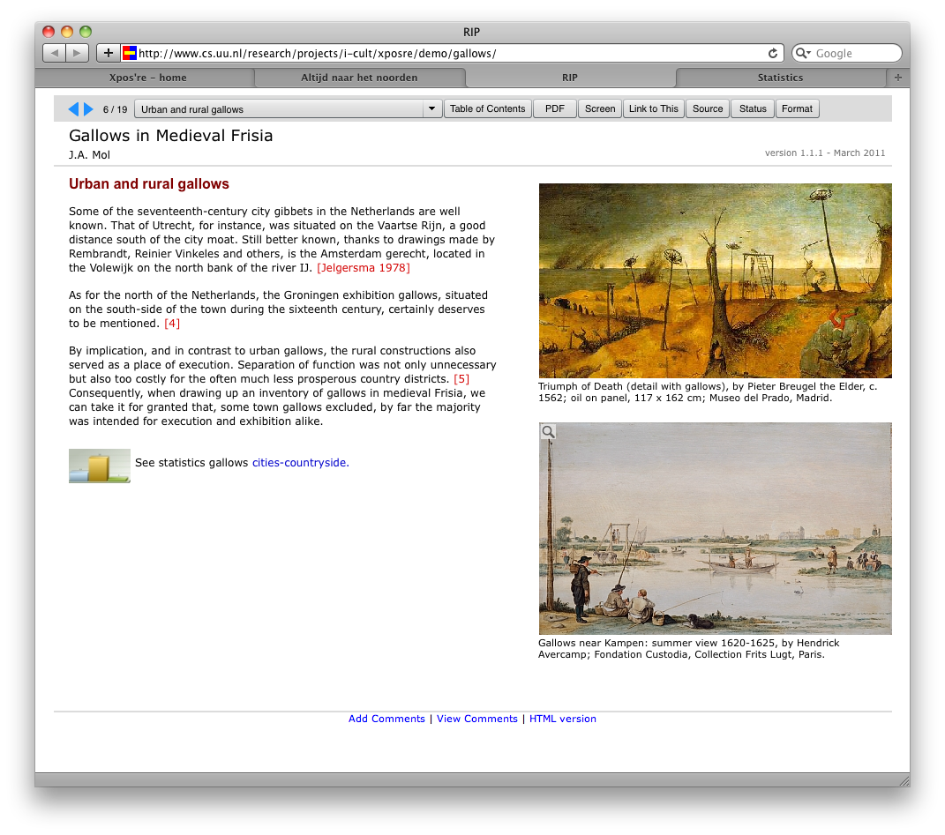
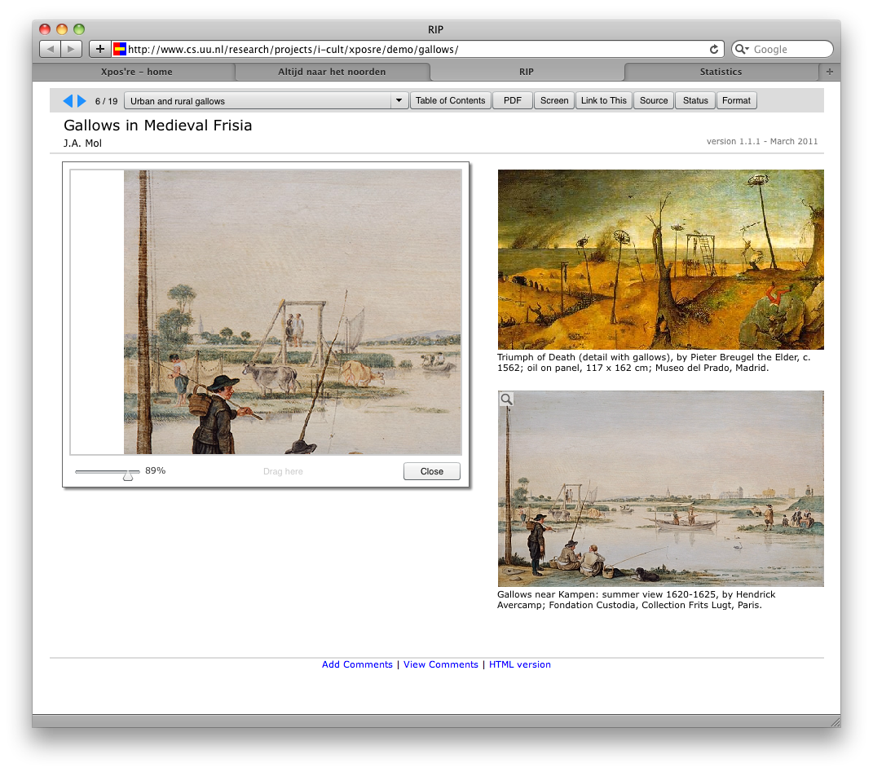
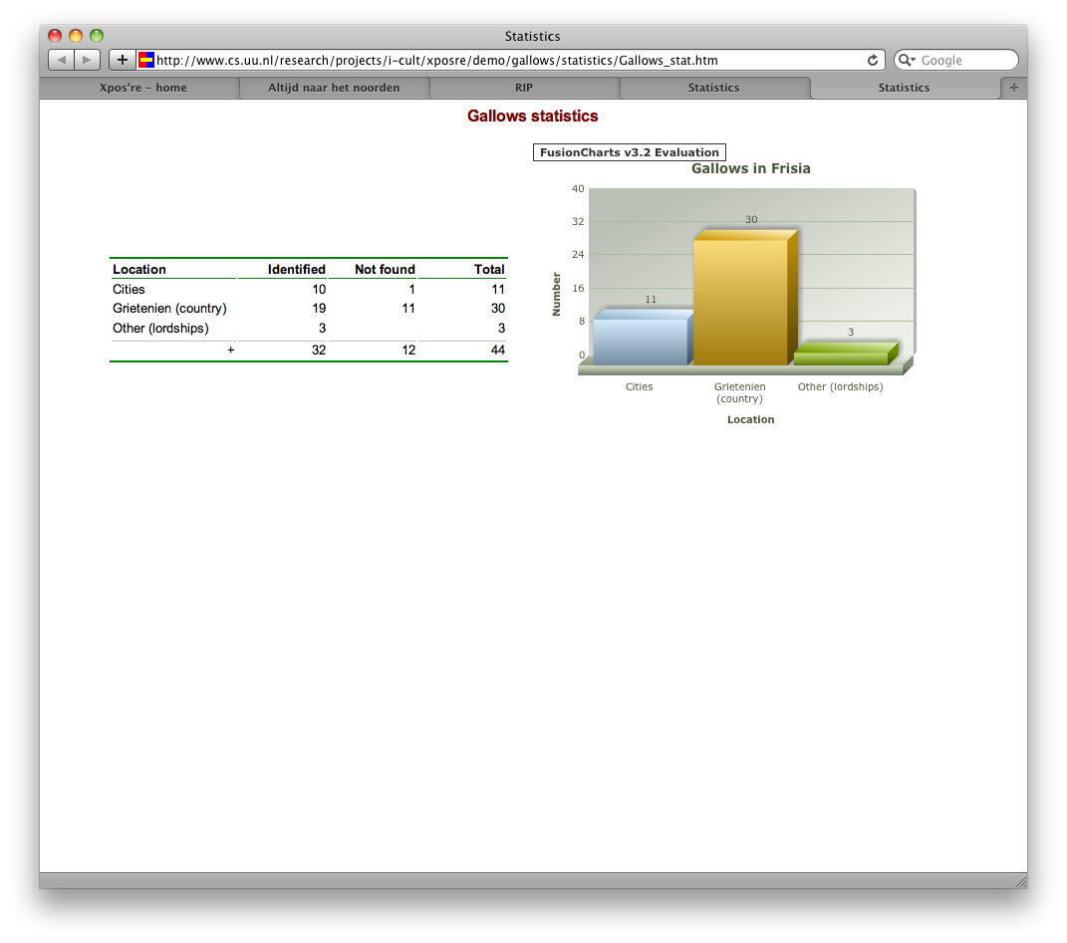
VPCross
Notes:
Focus on authoring: tools for writng publications with embedded enhancements. Little/no focus on LTP/repo

Slide 13
From bottom-up to top-down
What do researchers need?
  Bottom-up: Many different wishes / interpretations
How do we facilitate this in a sustainable way?
  Top-down: interoperability and durability
Enhanced Publications in Narcis
Durable Enhanced Publications

Slide 14
Enhanced Publications in Narcis

Slide 15
Enhanced Publications in Narcis
Index and visualize the enhanced publications in research portal Narcis.
Collect Resourcemaps
Validate Resource Maps
Ingest in TripleStore
Publish in Narcis
OAI-PMH
RDF Validator and Escape Visualizer
MERESCO
Narcis.nl

Slide 16
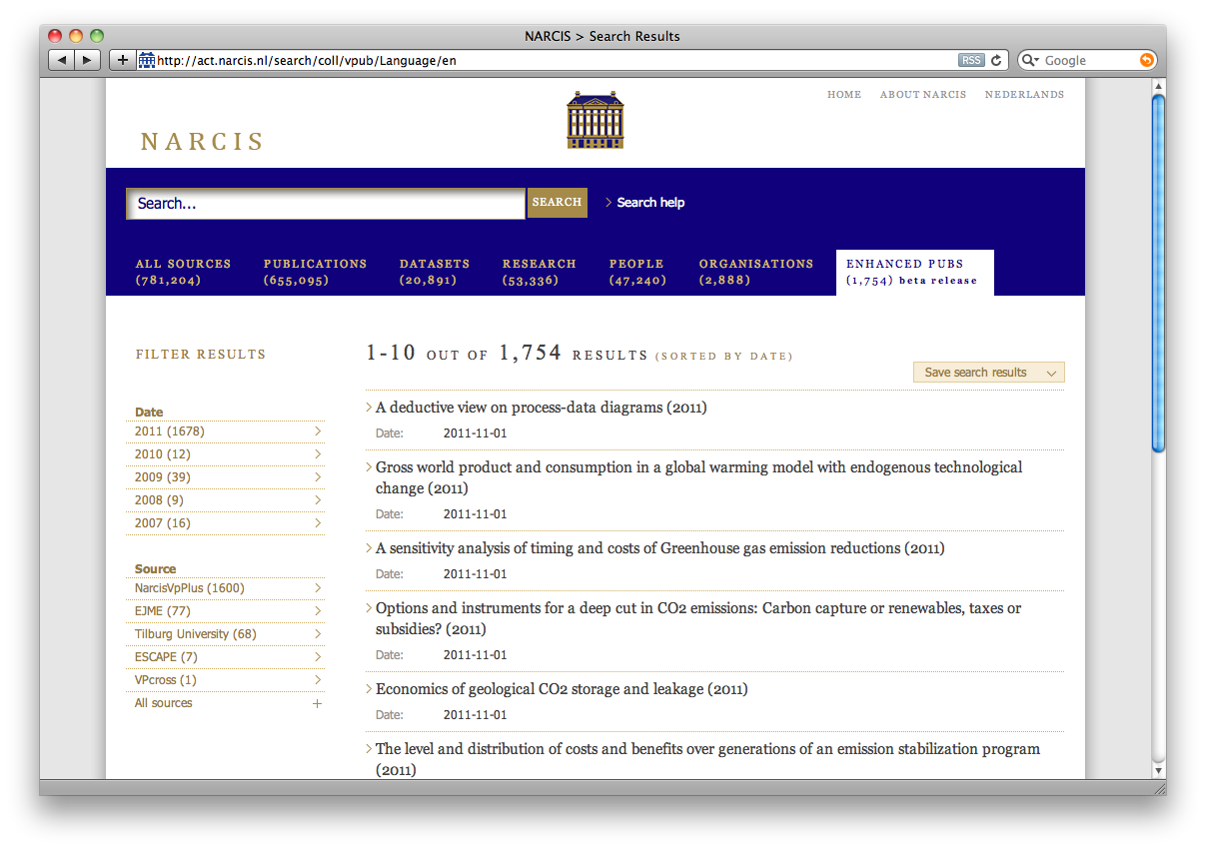
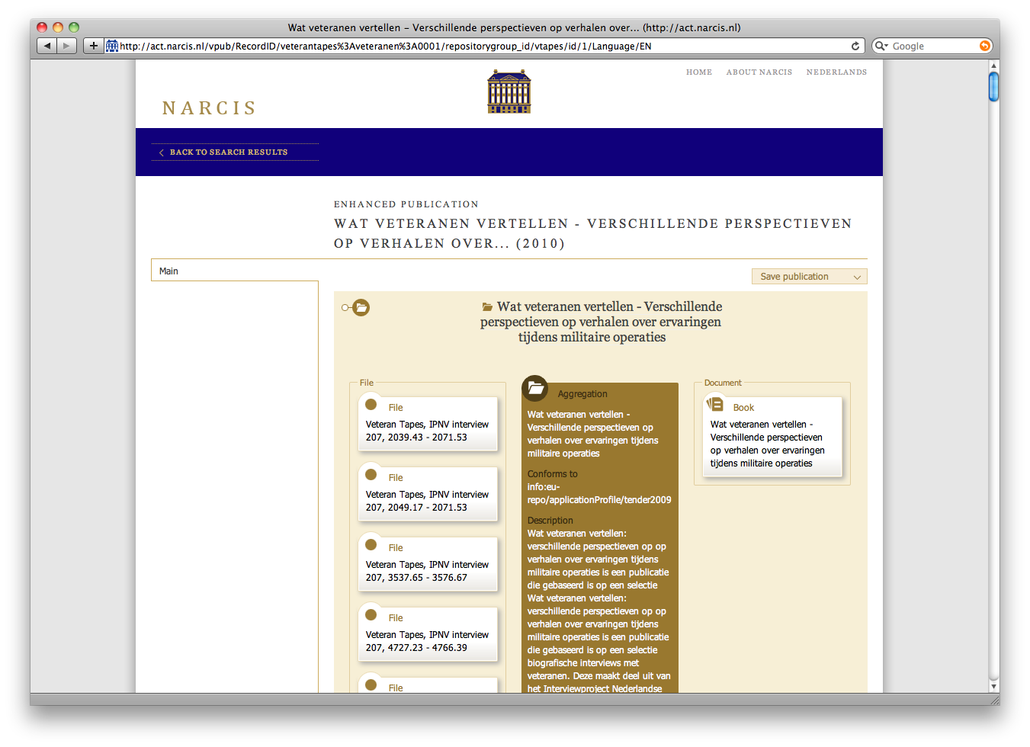
http://www.narcis.nl

Slide 17
Enhanced Publications in Narcis
Observations
  Most enhancements live outside repository
  No single way to discover resource maps
  Some resource maps contain invalid RDF
  Some resource maps not displayed correctly
Need body / organization to
  Define enhanced publication standards
  Validate standards
  Promote standards
(…or is there a smarter ‘Linked Data’ way?)
Notes:
When creating this sheet we realized that all of this assumes a controlled environment. Can/should we maintain this?

Slide 18
Durable Enhanced Publications
(preliminary results)

Slide 19

Durable Enhanced Publications
How can we ensure long-term scientific integrity?
Or…

Slide 20
Challenging heterogeneity
Level of integration
  Metadata, reference, link, embed
Level of commitment
  Web, Institutional Repository, LTP archive
Level of reference
  Start page, metadata, data file, fragments, visualized
Notes:
Refer to results from Enh. Publ. in Narcis.
Emphasize the difficulty of bottom-up approach, need for top-down approach

Slide 21
Level of integration
Data
visualized
in publication
Data within publication
Links within publication
Links within metadata
Notes:
Preserving visualization and software is a bridge too far
Stick to separate, durable objects and durable links
Relevance with Jim Gray pyramid?

Slide 22

Level of commitment
Pub
Video
Data Seal of Approval:
Trusted Digital Repository
Usable / durable formats
Sufficient metadata
Clear usage conditions
Persistent identifiers
Resource
Map
Notes:
Pub+Video Resources and Resourcemap
must be in TDP
And in usable formats
With sufficient metadata
And clear usage conditions
Links must be persistent

Slide 23
Observations (preliminary!)
 | TDP |  | Format | Metadata |  | PID | Conditions
Journal of Archaeology |  |  |  |  |  |  | t.b.d.
DatapluS |  |  |  |  |  |  | t.b.d.
Proefschriften Plus |  |  |  |  |  |  | t.b.d.
VPCross |  |  |  |  |  |  | t.b.d.
3TU. Datacentrum |  |  |  |  |  |  | t.b.d.
Notes:
Illustrate with many “bottom-up” examples from study
Eg JALC:
facilities have been built to load data from TDP, but publication could not be found via TDP/IR. Visualizations not in TDP/IR
Data in JSON (non-preferred @ DANS), visualizations not supported
little default metadata on file-level. Most RM-metadata was created by hand by non-expert.
PID-support developed, but not yet implemented for data. But the complete dataset is linked via pid

Slide 24
Recommendations
LTP Archives
  Support granularity: datasets, files and fragments
  Clear access structures: authentication, legal issues
  Unify archives: Unify interface, divide responsibilities
Publishers (of Enh. Pub.)
  Data availability policy
  Beware of advanced features / visualizations
Authors
  Deposit data
Notes:
If we take the shortcomings from the previous slide, what is needed to resolve most of these issues?
Begin by telling what you can do yourself: LTP Data archive. We facilitate so that others can be encouraged to take their responsibility

Slide 25
Summary
State of the art in the Netherlands
  A wide range if interpretations by researchers and repositories
Experience with usability
  Need more strict resource map ‘application profile’
  Need validation of resource maps
Experience with durability
  Need for clear data deposit- and access facilities
  Need for clear data deposit- and access policy
Notes:
Repeat TOC of beginning: This is where the message that we want to spread should be repeated.

Slide 26
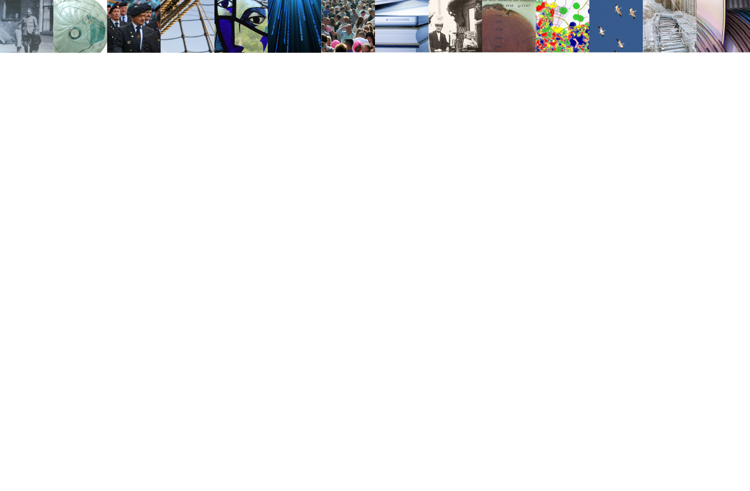
Thank you for your attention
For more information please contact
maarten.hoogerwerf@dans.knaw.nl

