Slide 1
“Life Undead” –
may Linked Open Data save us from (some) preservation problems?
Martin Iordanidis (hbz)
November 28/2011

Slide 2
Linked Open Data & Preservation
“Traditional” paradigm in digital preservation:
preservation at the end of the lifecycle
notion of an "end of economical lifecycle“
Q: ”how much do we lose if we do not preserve our data?”
"NASA-effect“: Pioneer/Viking projects 1976/1979
Linked Open Data & Preservation
Martin Iordanidis

Slide 3
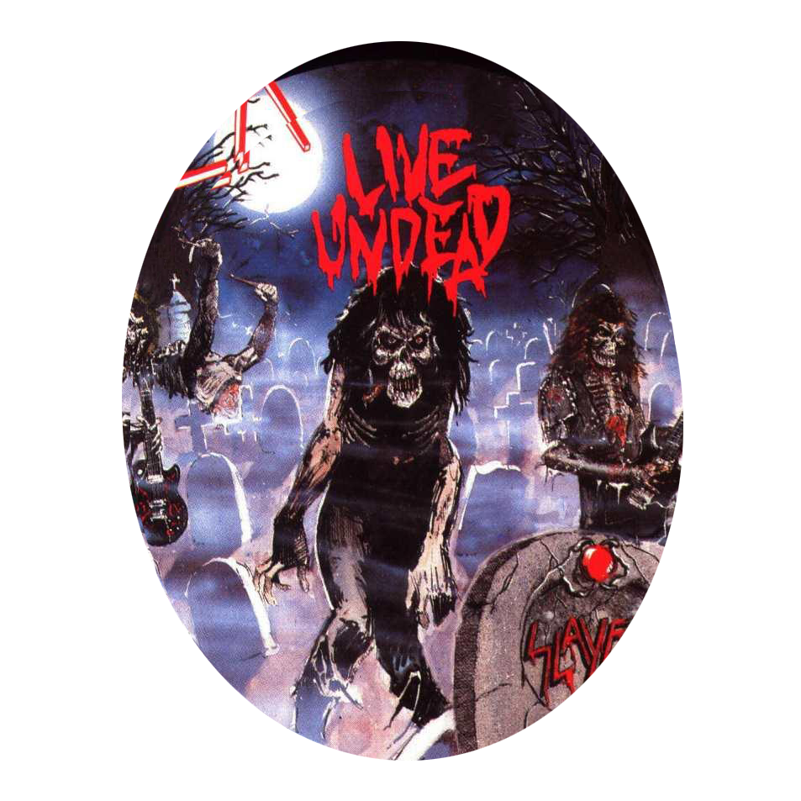
Linked Open Data & Preservation
„Life Undead“ situation
legacy data WILL cause problems
yes, it’s expensive
we don’t know how to handle it
we will lose substantial amounts of data,
money
business potential
knowledge
cultural heritage, arts, our collective memory....
Linked Open Data & Preservation
Martin Iordanidis

Slide 4
Linked Open Data & Preservation
Paradigm shift:
”(how much) does it pay off if we preserve?”
mandates are not enough
Preservation community looking for business cases
new notion of "value" that relies on re-use
there is no economic "end of lifecycle"
Linked Open Data & Preservation
Martin Iordanidis

Slide 5
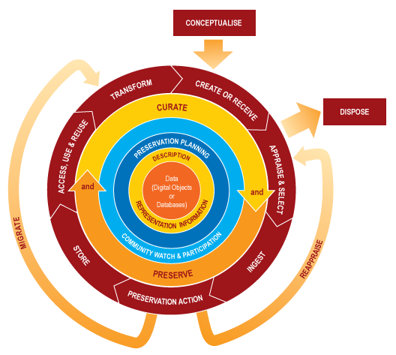
Linked Open Data & Preservation
Digital Curation Lifecycle Model (ca. 2008)
Linked Open Data & Preservation
Martin Iordanidis

Slide 6
Linked Open Data & Preservation
Digital Curation Lifecycle Model (ca. 2008)
(You are here)
Linked Open Data & Preservation
Martin Iordanidis

Slide 7
Linked Open Data & Preservation
Digital Curation Lifecycle Model (ca. 2008)
Recommendations:
take stapes to make data visible and accessible
maintain legal constraints (create and keep rights metadata)
assure integrity and authenticity
(You are here)
Linked Open Data & Preservation
Martin Iordanidis

Slide 8
Linked Open Data & Preservation
Aggregated resources?
Enhanced publications?
Digital Curation Lifecycle Model (ca. 2008)
take stapes to make data visible and accessible
maintain legal constraints (create and keep rights metadata)
assure integrity and authenticity
(You are here)
Linked Open Data & Preservation
Martin Iordanidis

Slide 9
Linked Open Data & Preservation
Re-use and preservation (ca. 2011/2012)
“Reference Model for Economically Sustainable Digital Curation” (BRTF, draft)
idea: no sharing, no use, no reason to preserve.
Re-use of digital resources may fuel digital preservation
Linked Open Data & Preservation
Martin Iordanidis

Slide 10
Linked Open Data & Preservation
The eco4R approach
eco4r
strongly promotes re-use within aggregated resources
can contain various metadata sets relevant to preservation
makes real life data more accessible
helps to increase value of digital resources by using them
eco4r plugins may produce RDF instantiations such as
Atom
RDF/XML
Turtle
N3
Linked Open Data & Preservation
Martin Iordanidis

Slide 11
Linked Open Data & Preservation
Enhanced Resource Map I
<?xml version="1.0" encoding="UTF-8" ?>
<rdf:RDF
xmlns:rdf="http://www.w3.org/1999/02/22-rdf-syntax-ns#"
xmlns:ore="http://www.openarchives.org/ore/terms/"
xmlns:dc="http://purl.org/dc/elements/1.1/">
<rdf:Description rdf:about="http://www.eco4r.org/rem">
<ore:describes rdf:resource="http://www.eco4r.org/" /></rdf:Description>
<rdf:Description rdf:about="http://www.eco4r.org/">
<dc:date>2011-07-07T11:33:29.133Z</dc:date>
<dc:title>Exposing Compound Object From Repositories</dc:title>
<ore:aggregates rdf:resource="http://www.eco4r.org/presentations/POCOS_RememberRestructureReUse_2011.pdf”/>
</rdf:Description>
</rdf:RDF>
Linked Open Data & Preservation
Martin Iordanidis

Slide 12
Linked Open Data & Preservation
Enhanced Resource Map II
<?xml version="1.0" encoding="UTF-8" ?>
<rdf:RDF
xmlns:rdf="http://www.w3.org/1999/02/22-rdf-syntax-ns#"
xmlns:ore="http://www.openarchives.org/ore/terms/"
xmlns:dc="http://purl.org/dc/elements/1.1/">
<rdf:Description rdf:about="http://www.eco4r.org/rem">
<ore:describes rdf:resource="http://www.eco4r.org/" /></rdf:Description>
<rdf:Description rdf:about="http://www.eco4r.org/">
<dc:date>2011-09-11T13:12:45.097Z </dc:date>
<dc:title>Exposing Compound Object From Repositories</dc:title>
<ore:aggregates rdf:resource="http://www.eco4r.org/presentations/POCOS_RememberRestructureReUse_2011.pdf”/>
<ore:aggregates rdf:resource="http://www.eco4r.org/presentations/presentations/LondonPosterAls.pdf" />
</rdf:Description>
</rdf:RDF>
Linked Open Data & Preservation
Martin Iordanidis

Slide 13
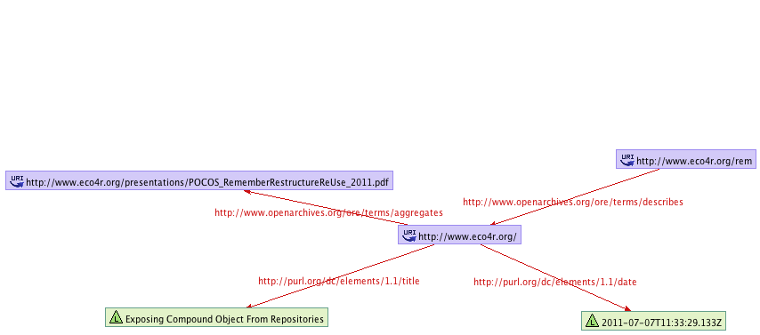
Linked Open Data & Preservation
Enhanced Resource Map III
Linked Open Data & Preservation
Martin Iordanidis

Slide 14
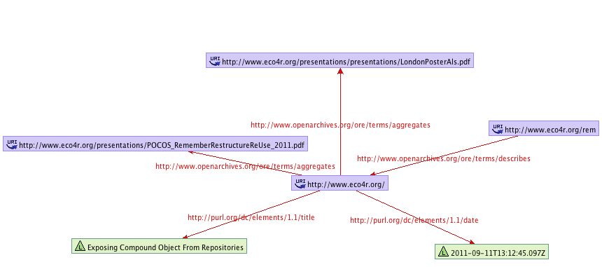
Linked Open Data & Preservation
Enhanced Resource Map IV
Linked Open Data & Preservation
Martin Iordanidis

Slide 15
Linked Open Data & Preservation
Enhanced Resource Map IV
Linked Open Data & Preservation
Martin Iordanidis

Slide 16
Linked Open Data & Preservation
Enhanced Resource Map IV
Linked Open Data & Preservation
Martin Iordanidis

Slide 17
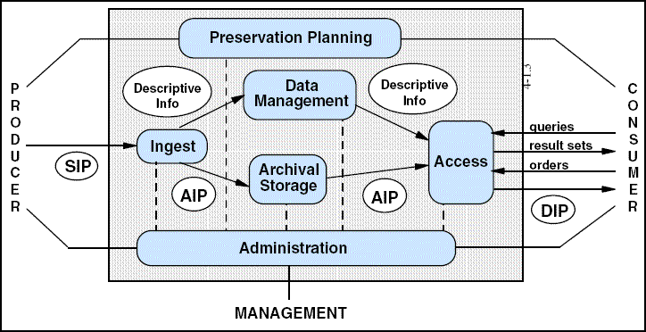
Linked Open Data & Preservation
Enhanced Resource Map
as a preservation process
Linked Open Data & Preservation
Martin Iordanidis

Slide 18
Linked Open Data & Preservation
Enhanced Resource Map
as a preservation process
Linked Open Data & Preservation
Martin Iordanidis

Slide 19
Linked Open Data & Preservation
Enhanced Resource Map
as a preservation process
Linked Open Data & Preservation
Martin Iordanidis

Slide 20
Linked Open Data & Preservation
Enhanced Resource Map
as a preservation process
Linked Open Data & Preservation
Martin Iordanidis

Slide 21
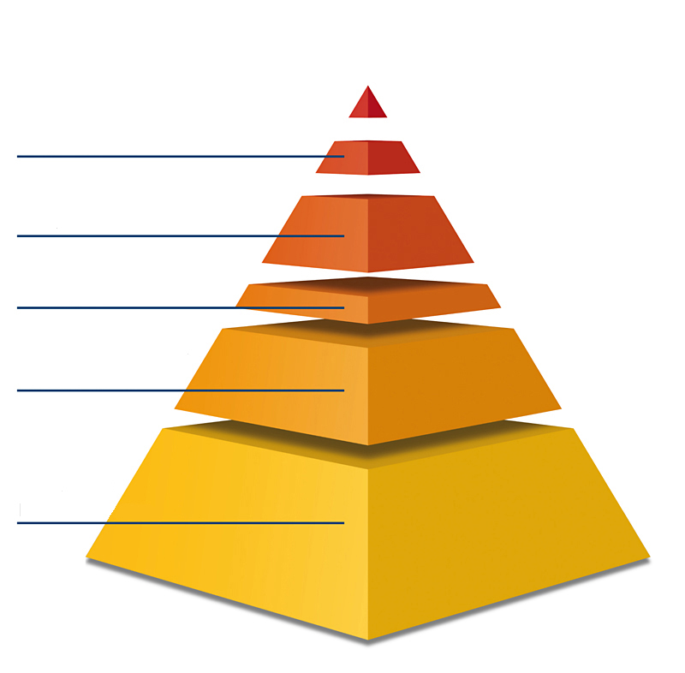
Linked Open Data & Preservation
Preservation Risks… …and how LOD may address them
Linked Open Data & Preservation
Martin Iordanidis

Slide 22
Linked Open Data & Preservation
Preservation Risks… …and how LOD may address them
bit rot / hardware failure
linking repositories
within LOCKSS networks
Linked Open Data & Preservation
Martin Iordanidis

Slide 23
Linked Open Data & Preservation
Preservation Risks… …and how LOD may address them
format / software/ OS obsolescence
linked open format registries / technology watch
bit rot / hardware failure
linking repositories
within LOCKSS networks
Linked Open Data & Preservation
Martin Iordanidis

Slide 24
Linked Open Data & Preservation
Preservation Risks… …and how LOD may address them
short / ceased fundings
extended use / low barrier exit strategies
format / software/ OS obsolescence
linked open format registries / technology watch
bit rot / hardware failure
linking repositories
within LOCKSS networks
Linked Open Data & Preservation
Martin Iordanidis

Slide 25
Linked Open Data & Preservation
Preservation Risks… …and how LOD may address them
authenticity / integrity
trusted metadata i.a. authority files
short / ceased fundings
extended use / low barrier exit strategies
format / software/ OS obsolescence
linked open format registries / technology watch
bit rot / hardware failure
linking repositories
within LOCKSS networks
Linked Open Data & Preservation
Martin Iordanidis

Slide 26
Linked Open Data & Preservation
Preservation Risks… …and how LOD may address them
lack of awareness
permanent use and re-use
authenticity / integrity
trusted metadata i.a. authority files
short / ceased fundings
extended use / low barrier exit strategies
format / software/ OS obsolescence
linked open format registries / technology watch
bit rot / hardware failure
linking repositories
within LOCKSS networks
Linked Open Data & Preservation
Martin Iordanidis

Slide 27
Linked Open Data & Preservation
A few (very careful) conclusions
Linked Open Data may decrease dependecies on heavy-weight preservation platforms
Repositories and/or websites using LOD may adapt certain preservation services (technology watch, format registries, emulation databases)
Digital preservation can benefit from interoperability on the level of metadata
Linked Open Data may lead to trusted metadata - under certain circumstances.
Linked Open Data & Preservation
Martin Iordanidis

Slide 28
Linked Open Data & Preservation
Thank You.
E-Mail: iordanidis@hbz-nrw.de
Twitter: @MIordanidis
Linked Open Data & Preservation
Martin Iordanidis

